Slide 1
AUSTIN TRAFFIC INCIDENT ANALYSIS
Insights for Improved Road Safety
BAX372T Advanced Programming
Carol Le
Nhu Tran
Luis Castaneda
Notes:
Luis

Slide 2

133,793
number of traffic incidents reported in Austin, TX
May 2022 - Dec 2024
Notes:
Luis

Slide 3
01
PROJECT GOALS
Identifying traffic incident-prone intersections, neighborhoods, and specific subsections of Austin.
Analyzing patterns related to specific days, times, and months that experience higher rates of traffic incidents.
Providing insights that can guide city planners and policymakers in directing resources to areas that need them the most.
Notes:
Kaity

Slide 4

DATA COLLECTION
02
Notes:
Carol

Slide 5


DATASETS
Incidents Data
Weather Data
Source: City of Austin Open Data Portal
Columns:
- Traffic Report ID
- Published Date
- Issue Reported
- Latitude
- Longitude
- Address
- Agency
Source: Visual Crossing Weather
Columns:
- datetime
- temp
- humidity
- precip
- windspeed
- cloudcover
- visibility
Collision
Traffic Hazard
Icy Roadway
Boat Accident
Obstruct Highway
Notes:
Carol

Slide 6
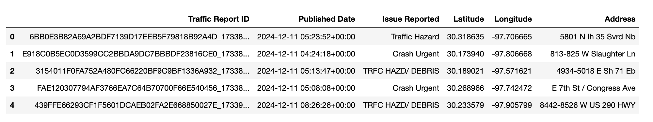
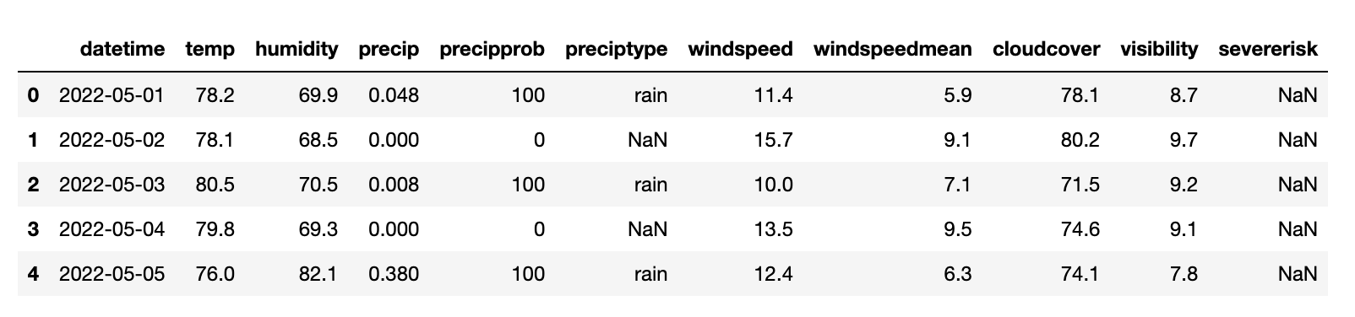
Incident Sample Data
Weather Sample Data
Notes:
Carol

Slide 7
03
EXPLORATORY DATA ANALYSIS
Notes:
Kaity

Slide 8
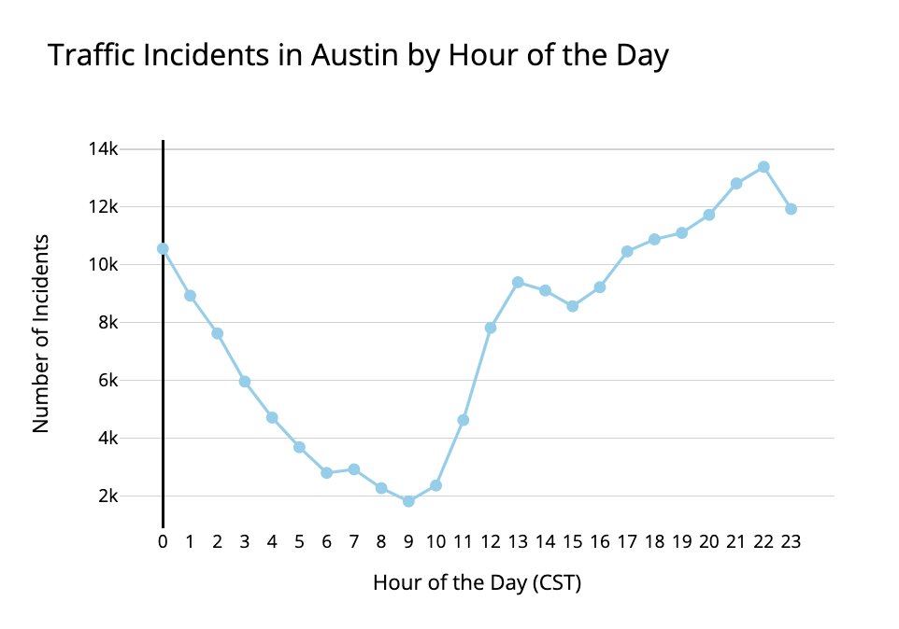
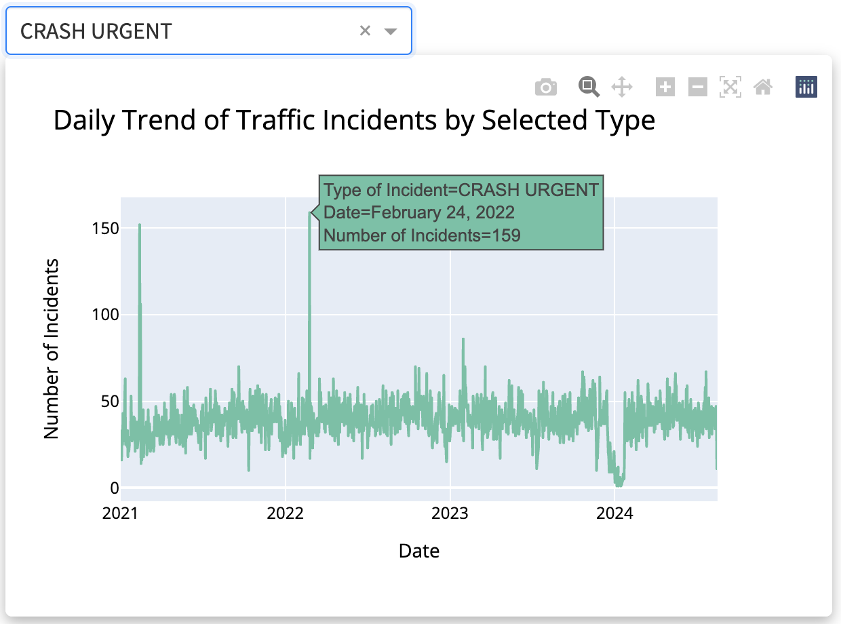
VISUALIZATIONS
PLOTS
Notes
Notes:
Kaity

Slide 9
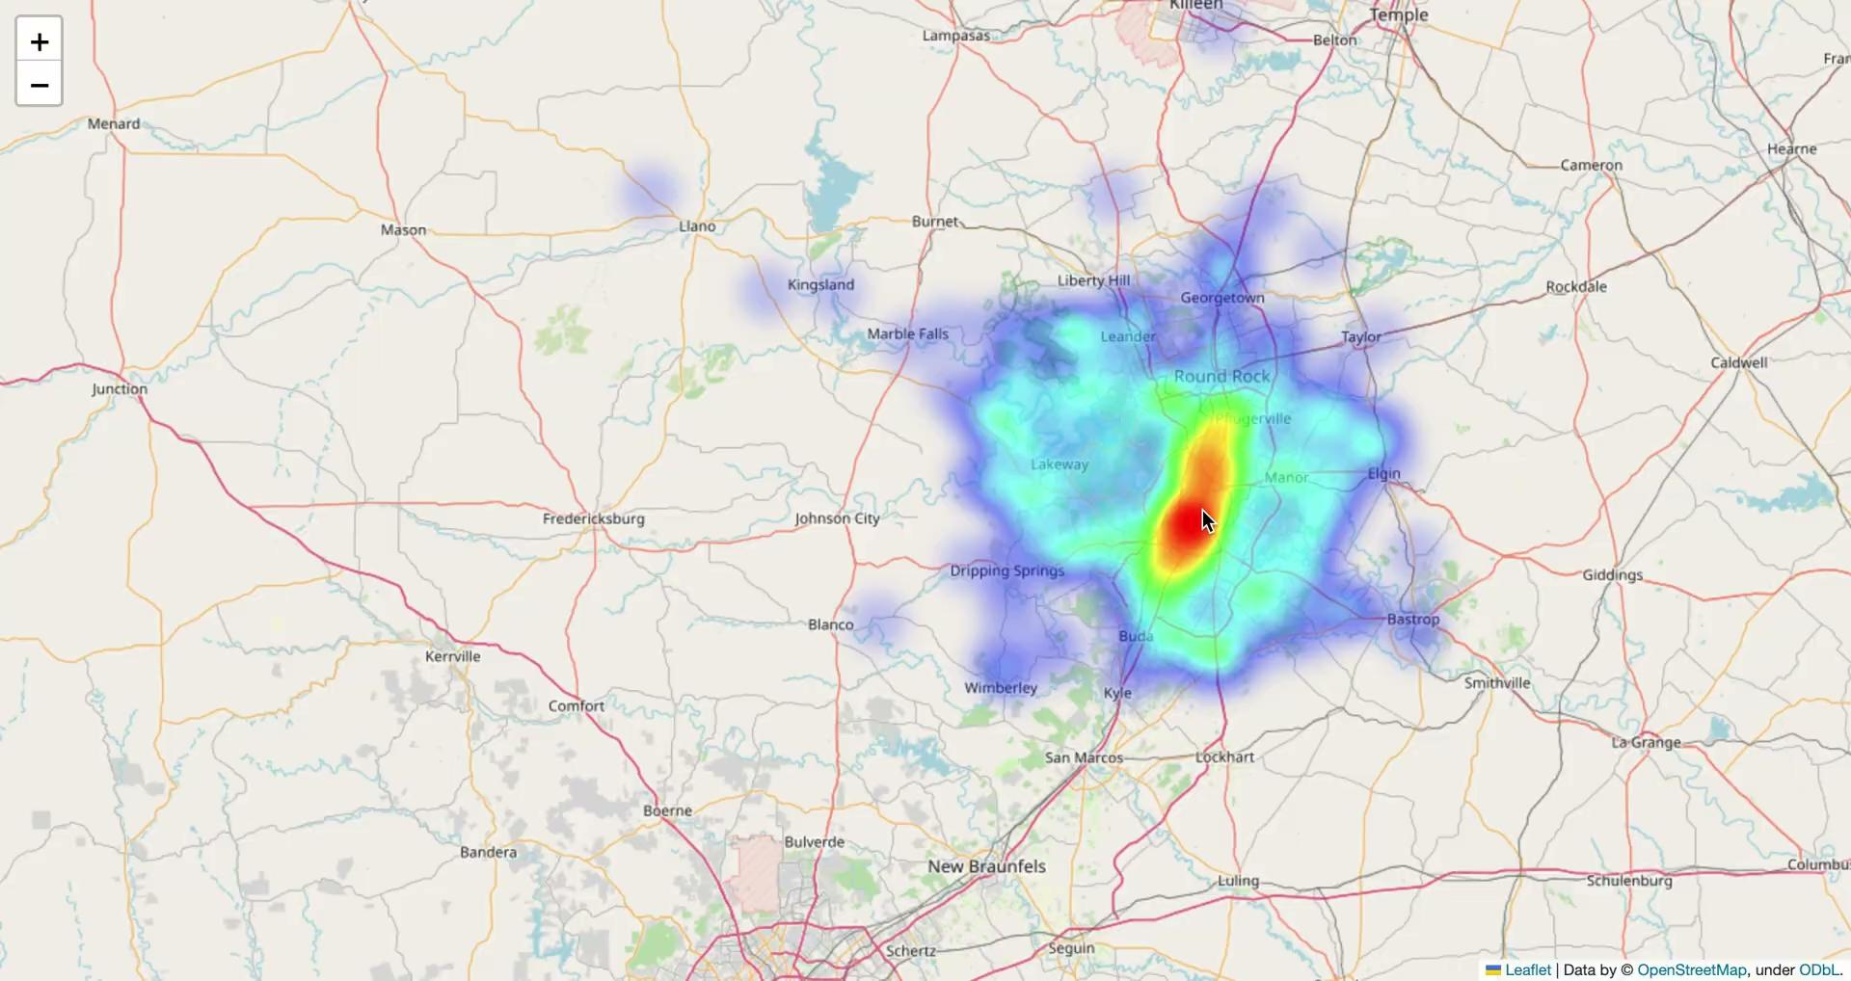
Notes:
Luis

Slide 10
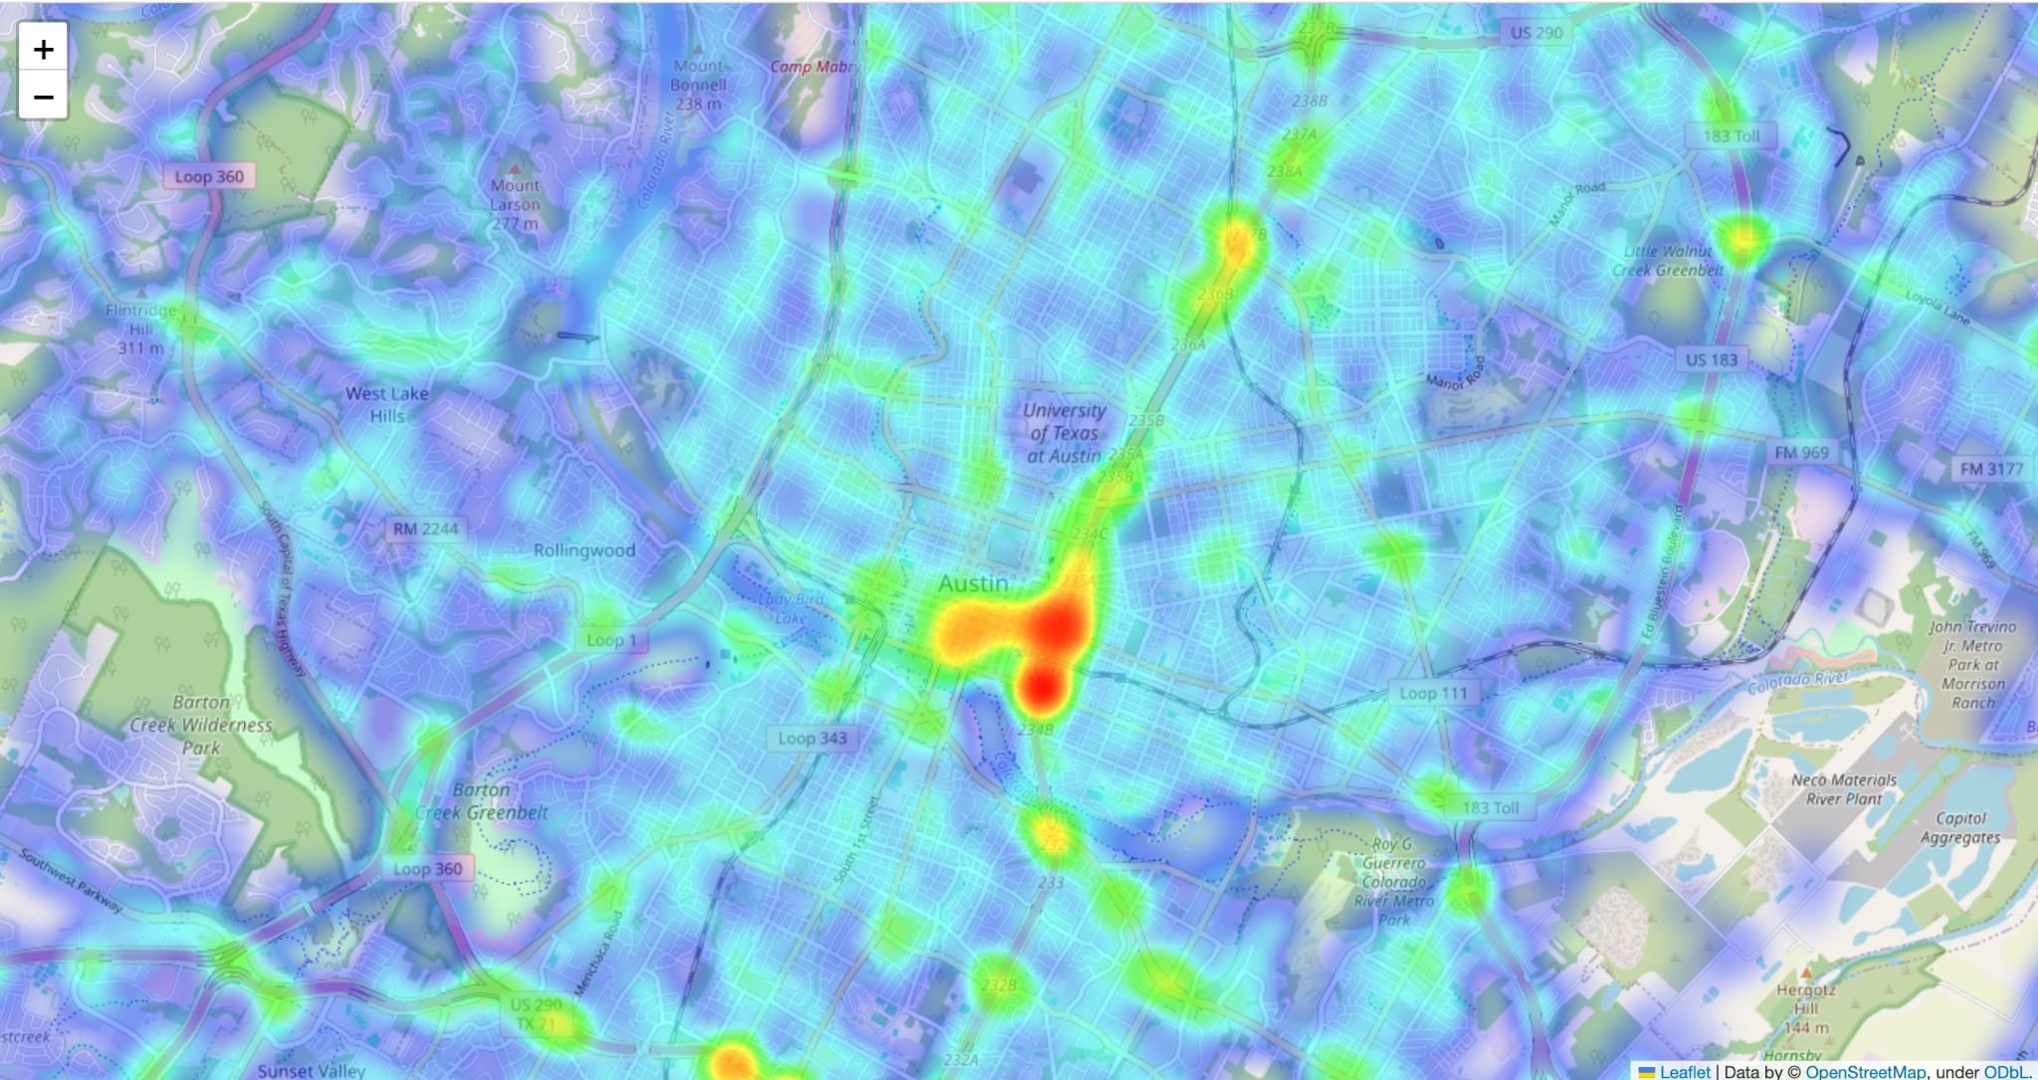

Slide 11

CLASSIFICATION MODEL
04
Notes:
Carol

Slide 12
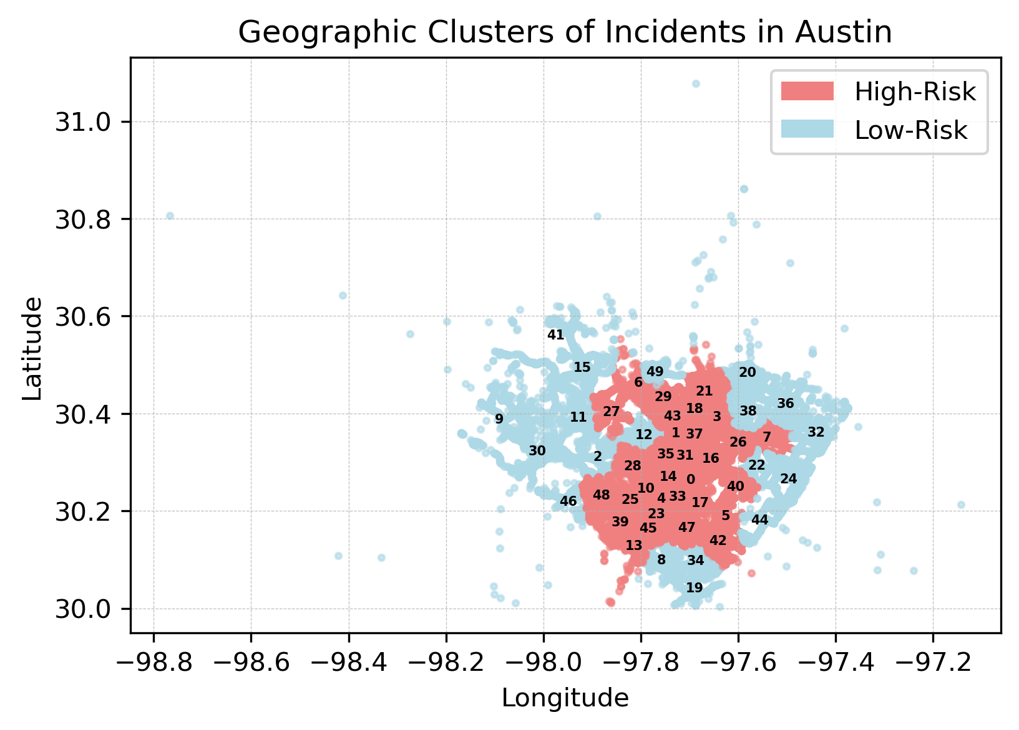
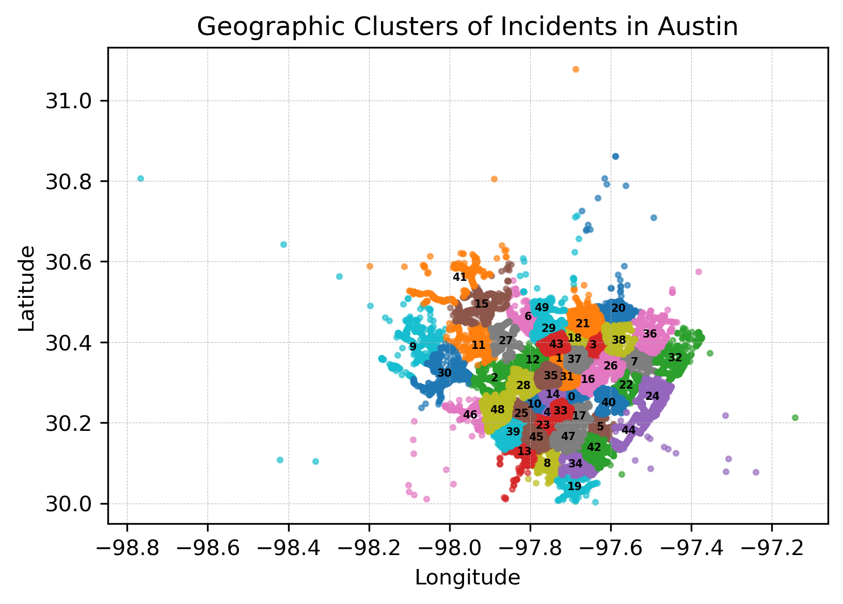
CLASSIFICATION MODEL
GOAL
01
DEFINE “HIGH-RISK”
02
“Out of all the areas that an incident had occurred, which ones are actually high-risk, which ones are low-risk?
Cluster incident locations using KMeans into 50 geographic clusters
Clusters with >1,000 incidents (7-8 a week) were labeled as high-risk
Notes:
Carol

Slide 13
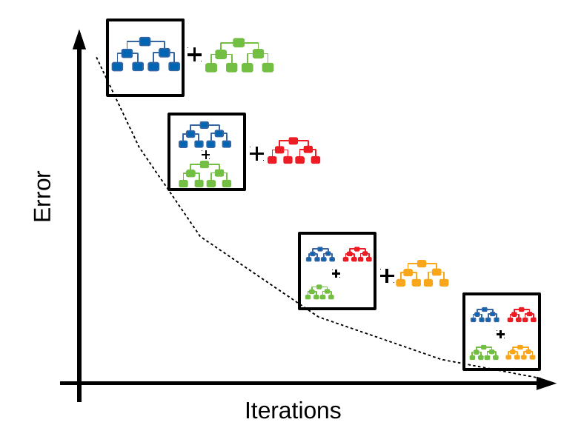
CLASSIFICATION MODEL
ENGINEER FEATURES
03
TRAIN A CLASSIFIER
04
hour
day_of_week
month
rush_hour
AM/PM
temp
precip
windspeed
cloudcover
visibility
Bagging
Random Forest ➼ n_estimators = 10
Gradient Boosting ➼ n_estimators = 200 ➼ max_depth = 4
Notes:
Carol

Slide 14
GRADIENT BOOSTING MODEL OUTPUT
72.35%
85.50%
Baseline Accuracy
Gradient Boosting Test Accuracy
High-risk (y=1)
Precision = 68%
Recall = 94%
Notes:
Luis

Slide 15
NEXT STEPS
Additional Data Enrichment
Model Refinement & Exploration
Validation & Dashboarding
Better data quality
More historical data sources
Less arbitrary values
Additional feature engineering
Tune model hyperparameters
Experiment with other ML models
Sensitivity Analysis (Examine the effect of a change in data or parameters)
Dashboard to present to potential clients
Notes:
Luis and Carol

Slide 16
PRACTICAL IMPACTS
Improved Traffic Safety
01
Better Emergency Response
02
Knowing “high-risk” area, the city can implement targeted safety measures:
Enhanced signage
Improved road infrastructure
Better lighting
More frequent traffic enforcement during high-risk periods
Understanding incidents pattern can lead to:
More efficient deployment of emergency personnel
Reducing response times
Improving outcomes for accident victims
Notes:
Kaity

Slide 17
DRIVE SAFE!
THANKS :)
Do you have any questions?
Notes:
Kaity

